Slide 1
Capital Budgeting Risk Analysis
João Carvalho das Neves
Professor, Leadership & Finance
ISEG Universidade de Lisboa
jcneves@iseg.ulisboa.pt

Slide 2
Decisions under risk and uncertainty
RISK
Unknown outcome in the future which can be attributed to the probability of the event
UNCERTAINTY
Unknown outcome in the future which can not be attributed to the probability of event

Slide 3
Sources of Risk and Uncertainty
Development of demand, prices and costs
No. of similar investments
Bias of individuals towards pessimism or optimism, or by factors which should not be considered
Changing economic environment that invalidates the past experience
Misinterpretation of data
Incorrect analysis
Dependence on management skills
Inflexibility of the investment
Asset obsolescence

Slide 4
Methods for analysis of risk and uncertainty
INTUITIVE APPROACH
ANALYTICAL APPROACH
Qualitative/Subjective
Payback period adjusted to risk
Discount rate adjusted to risk
Cash flow adjusted to risk
Probabilistic distribution
Decision trees
NPV break even-point
Sensitivity analysis
Scenario analysis
Monte Carlo simulation
Decision theory

Slide 5
Sensitivity analysis oTobai Company, Osaka, Japan (Brealey et al., 2008, p. 271-283)
1. Assumptions
(inputs, no formulas)
2. Cash flow model
(no data, formulas only)
3. Output
(no data, formulas only)

Slide 6
oTobai Company - Sensitivity analysis

Slide 7
Sensitivity analysis
See Data Table Analysis in EXCEL
One way
Two ways

Slide 8
Look for unidentified variables in the model
Patent problems to be resolved yet?
Is there enough power service stations to recharge the scooter batteries?
Does the company need to do additional investments in power stations?
Does this have a potential impact lowering the assumed demand?
The greatest risks often lie in the unknown unknowns (“unk-unks”)

Slide 9
The value of additional information
You can check whether you can resolve some of the uncertainty previously identified, before the company spends 15 billions of yens.
What if the production is forecasting an extra 20.000 yen per unit because the people from production are worried about the risk on the use of a specific machine?
$$100.000 units×Y20.000/unit×\left(1−0,5\right)$$
$$Impact in NPV=\sum_{i=1}^{10}{\frac{Y 1b}{{\left(1+0,1\right)}^{i}}}=Y6,14b$$
This would destroy the value of the scooter project: +Y 3,43b – Y 6,14b = - Y 2,71b
Is that possible to do something to minimize this risk? For example
What if you know that the chance of this risk to occur is 1 in 10 and you need to invest Y10 million to test the machine?
$$− Y 10M+0,1×Y 6,14b=+Y 604M$$
The value of additional information about market size is small as the project is acceptable even under pessimistic assumptions

Slide 10
Limits to sensitivity analysis
Advantages
Limitations
Forces managers to identify the underlying risk drivers
Indicates where additional information is most useful
Helps to expose confuse or inappropriate forecasts
It always give some ambiguous results. What does optimistic and pessimistic means?
the underlying input variables are likely to be interrelated. Example: market share penetration and unit price, or unit price and unit cost
as a consequence you cannot push one-at-a-time sensitivity analysis too far

Slide 11
Scenario Analysis
If the input variables are interrelated it may help to consider some alternative plausible scenarios, such as rise or decline in oil prices, improve versus deterioration of purchasing power, etc.
It allows to look at different but consistent combinations of variables

Slide 12
SCENARIO ANALYSIS
Scenarios can be based in most varied factors such as:
Macro-economics (inflation, GDP growth, unemployment, etc.)
Political (change of government, no change in government policy, etc.)
Industry based (level of competition, innovation, etc.)
Company (growth, sales gross margin, restructuring costs and savings, etc.)
See Tools/Scenarios in EXCEL

Slide 13
Scenario Analysis – otobai in excel

Slide 14
Development of scenarios
1) Selection of critical variables
2) Selection of values for the variables in each scenario
3) Calculation of PV for each scenario
4) Analysis of value in each scenario
5) Decide on the asset valuation (or equity valuation) given the value of each scenario. You may attribute probabilities to each scenario and obtain a weighted valuation

Slide 15
Scenario analysis limitations
Scenarios are discrete - Optimistic, Most probable, Pessimistic
Complexity of analysis grows very quickly with the increase of critical variables (e.g.: 15 variables x 3 scenarios => 45 Expected values)
There is no optimal recommendation on how to use the results

Slide 16
NPV break-even vs. Accounting Break-even
Use Goal Seek in EXCEL searching NPV = 0 changing the cell of volume
Units: 85 098
Calculation of accounting break even:
$$BEP= \frac{Y 4.500 M}{Y 75.000}=60.000 units$$
Why the accounting and NPV break even are different?
Notes:
Opportunity cost of capital
Timing of cash flows

Slide 17
Monte Carlo simulation
Market Size
Probability Distribution of Independent Variables
EV
Selling Price
EV
Market Growth Rate
EV
Market Share
Investments
Random values for each variable
Terminal Value
Variable Costs
Economic Life of Equipment
NPV calculation for each combinations of input variables
Fixed Costs
NPV
Repetition by N times
N tends to infinite
Output
probability
Risk Analysis
Valuation Definition

Slide 18
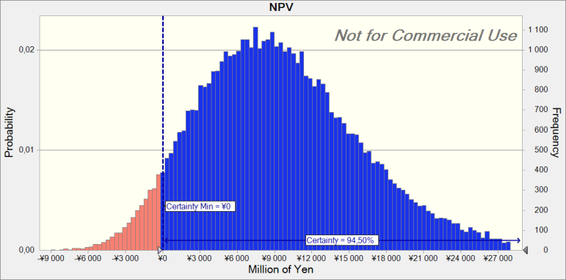
Otobay company – crystal ball – monte carlo simulation

Slide 19
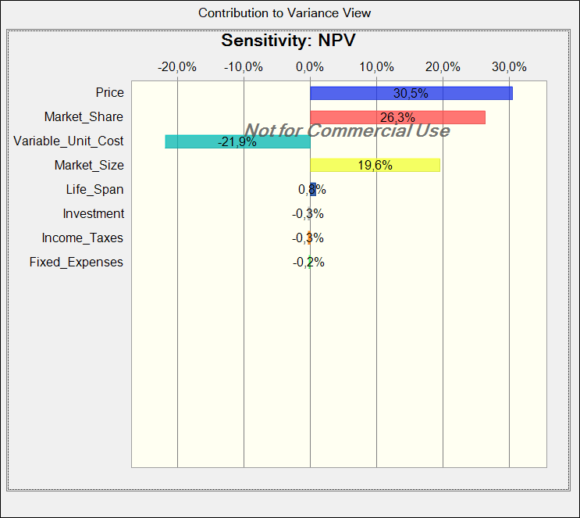
Sensitivity Analysis – Otobai – Crystal Ball

Slide 20
Tornado Analysis – otobai case

Slide 21
Which distributions should you use?

Slide 22
Which distributions should you use?

Slide 23
Which distributions should you use?

Slide 24
Which distributions should you use?

